Slide 1

Extra Tutorial - Seq2Seq & Advanced Huggingface
Naveh Porat
November 2022

Slide 2
Table of Contents
01
04
Training Seq2Seq Models
Inheriting & Overriding HF Trainers
02
05
Freezing HF Models
Hyperparameter Tuning with W&B
03
Inheriting & Overriding HF Models

Slide 3
Recap

Slide 4
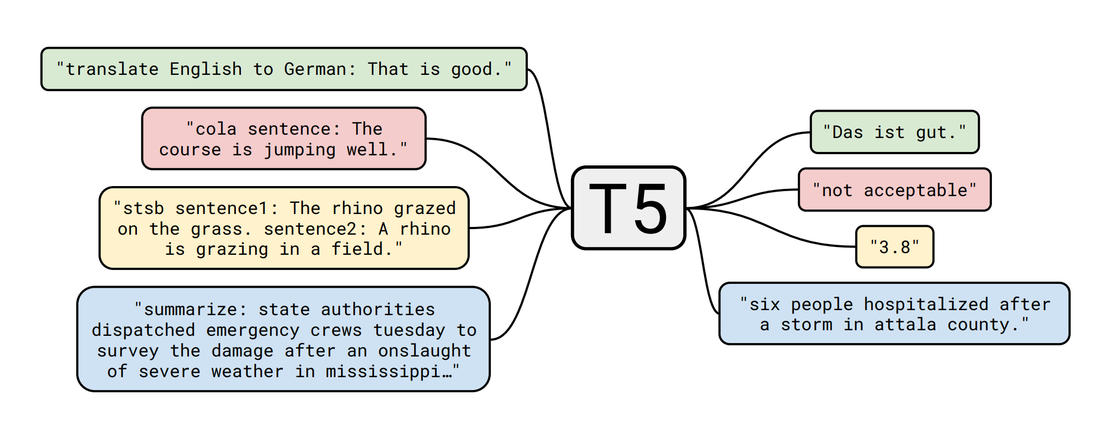
Seq2Seq

Slide 5
Today’s Dataset - XSum
The Extreme Summarization (XSum) dataset is a dataset for evaluation of abstractive single-document summarization systems.
The goal is to create a short, one-sentence new summary answering the question “What is the article about?”.
The dataset consists of 226,711 news articles accompanied with a one-sentence summary. The articles are collected from BBC articles (2010 to 2017) and cover a wide variety of domains

Slide 6
Today’s Code
Today we sill use a Github repo I created.
The code is very similar to the project template I shared with you in the past, only adapted to Seq2Seq training and a bit simplified.
In the repo we have different branches for different concepts we would like to see today.
Try to follow along with the code!

Slide 7
Code Demo!

Slide 8
Freezing Layers of a HF Model

Slide 9
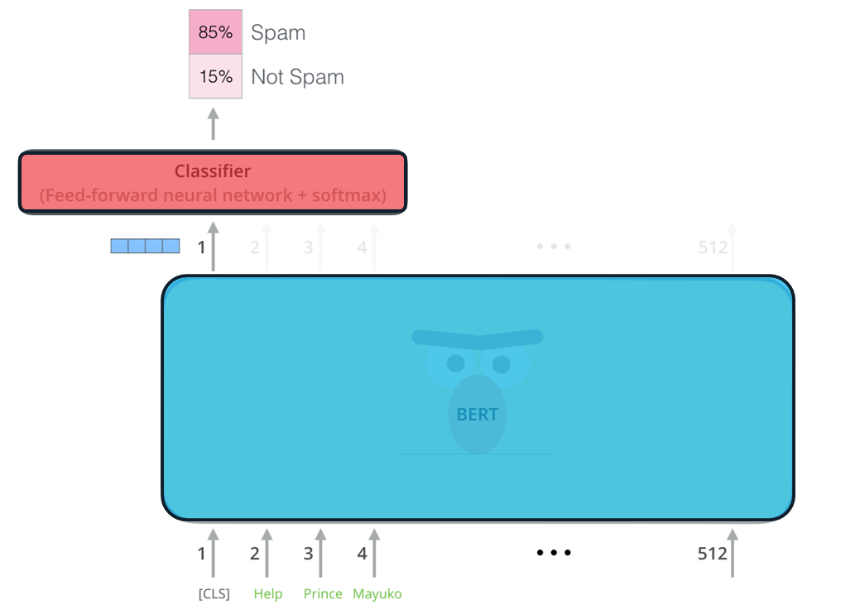
Recap
We save that sometimes we might want to freeze some of the model’s parameters so they won’t change in the fine-tuning stage.

Slide 10
Code Demo!

Slide 11
Task 1
Try and implement a method that freezes the encoder of any T5 HF module:
Implement freeze_encoder(model) that freezes the encoder of a T5-small model.
Add an argument to training_args called freeze_encoder
After loading the model in the train_model method, add an if clause that freezed that calls freeze_encoder(model) if training_args. freeze_encoder is True.

Slide 12
Task 2
Try and implement a method that freezes the last layer of any T5 HF module:
Implement freeze_last_layer(model) that freezes the last layer of a T5-small model.
Add an argument to training_args called freeze_last_layer
After loading the model in the train_model method, add an if clause that freezed that calls freeze_last_layer(model) if training_args. freeze_last_layer is True.

Slide 13
Inheriting & Overriding HF Model

Slide 14
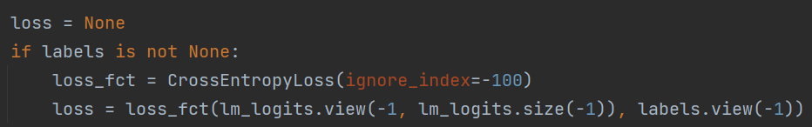
Inheriting & Overriding HF Model
Sometimes we wish to modify the behavior of a HF model.
For example, this code segment is taken from the forward method of the T5ForConditionalGeneration class:
What would we do if we want to add weights to the loss?

Slide 15
Inheriting & Overriding HF Model
Find the code of the class we want to modify its behavior. This can be found in transformers.models.model_name.modeling_model_name.
Create a new class that inherits from it.
Copy the code of the method we want to override to the new class.
Make our modifications.

Slide 16
Code Demo!

Slide 17
Inheriting & Overriding HF Trainers

Slide 18
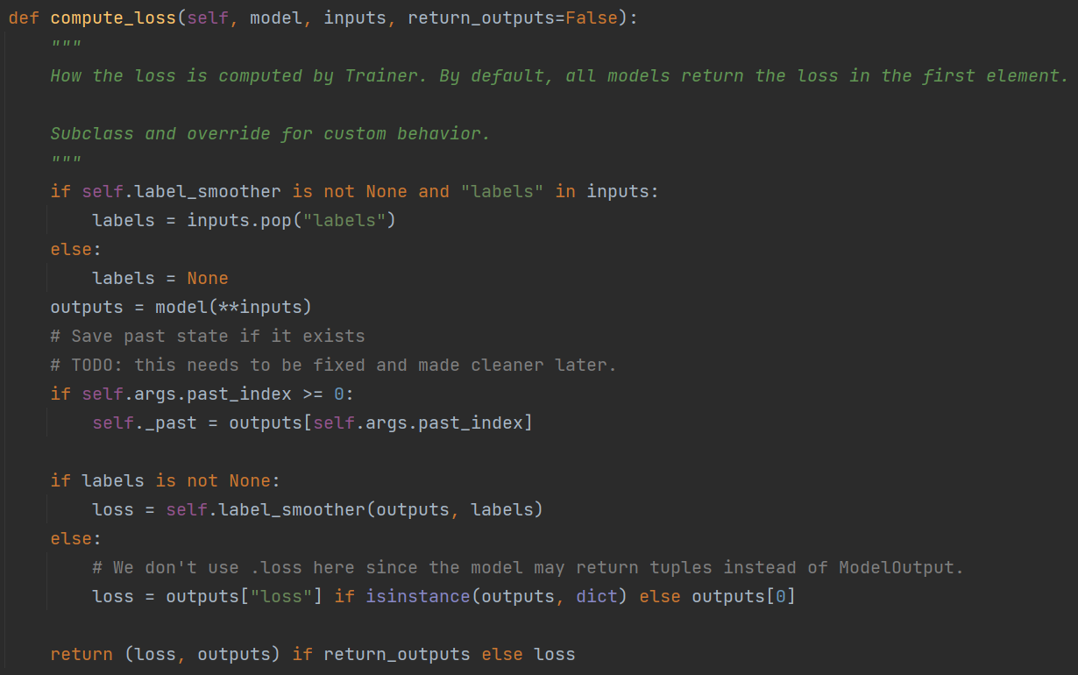
Inheriting & Overriding HF Model
Sometimes we wish to modify the behavior of a HF trainer.
For example, this code segment is the default compute_loss method of HF’s Trainer class:
What would we do if we wanted to compute a different loss by ourselves? Or perhaps something in the training process?

Slide 19
Inheriting & Overriding HF Trainer
Find the code of the method we want to modify. This can be found in transformers.trainer.
Create a new class that inherits from Trainer.
Copy the code of the method we want to override to the new class.
Make our modifications.

Slide 20

HF Trainer Limitations
Huggingface trainer is very rigid. This means it’s very useful for the basic usage, and contains only some advanced features.
If we want to employ an irregular training process, or seek a feature that HF trainer does not provide, we should seek a more flexible alternative.
Many people use Pytorch Lightning. It’s similar to HF’s trainer in some ways, but way more generic.

Slide 21
Code Demo!

Slide 22
Hyperparameter Tuning with W&B

Slide 23
Hyperparameter Tuning with W&B
In order to perform hyperparameter tunining efficiently we will use weights & biases sweep.
Another alternative is running bash scripts of all the experiments.
Another library for hyperparameter optimization that does not include a logger is Optuna.

